Slide 1
Monte-Carlo tree search with
Uncertainty propagation
via optimal transport
Shri Prathaa & Clifford

Slide 2
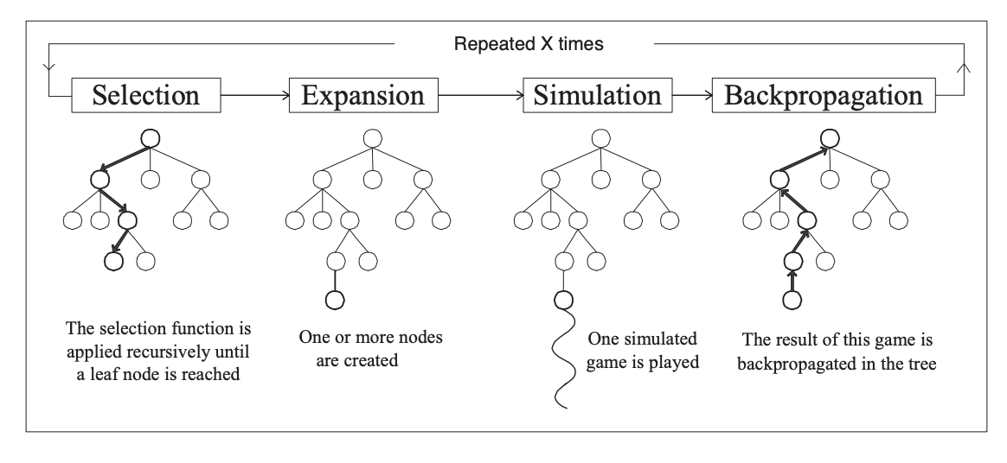
Monte Carlo Tree Search

Slide 3
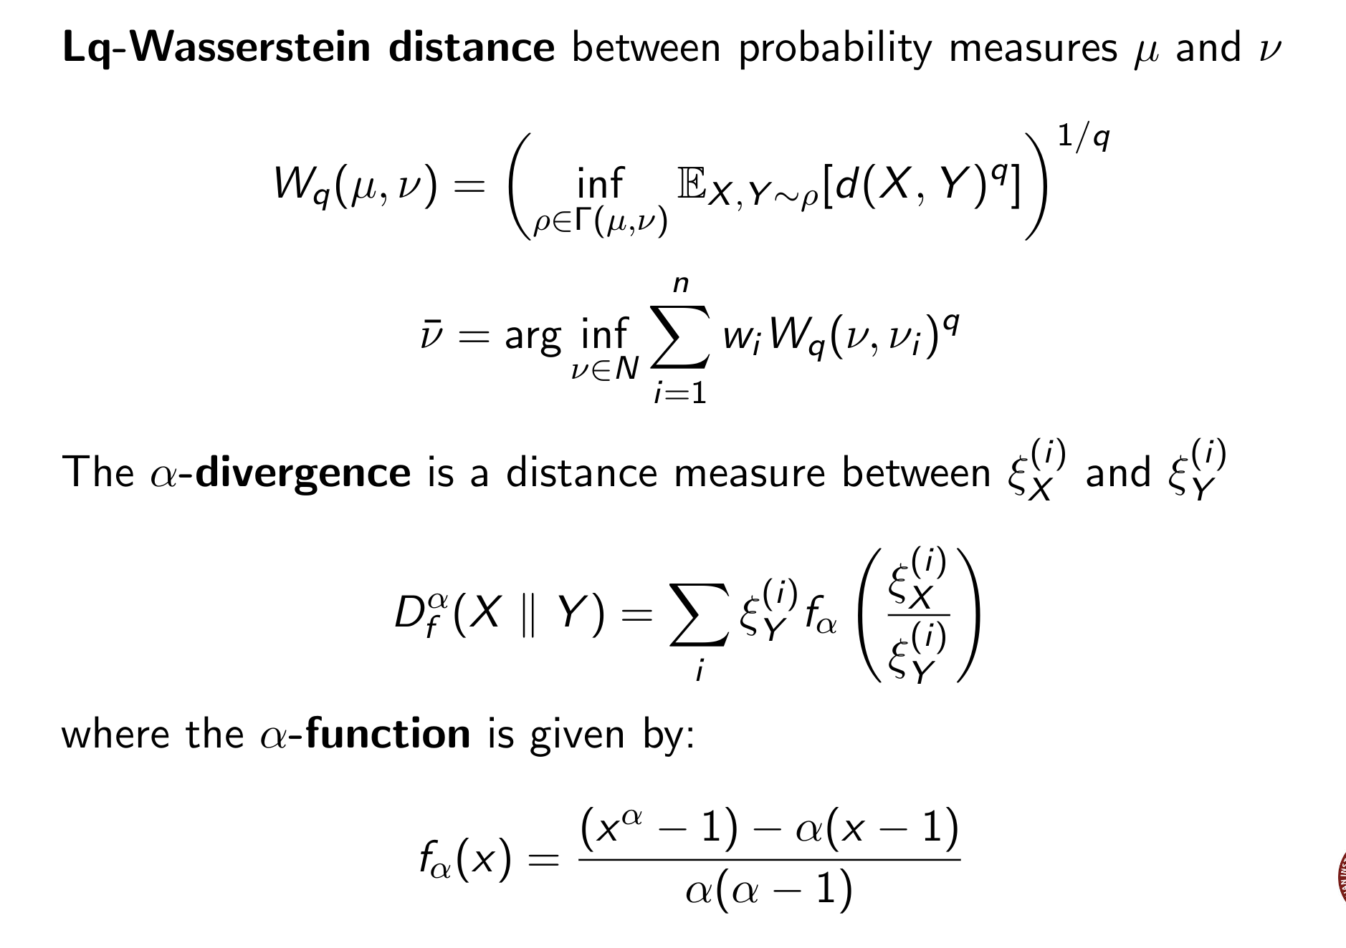
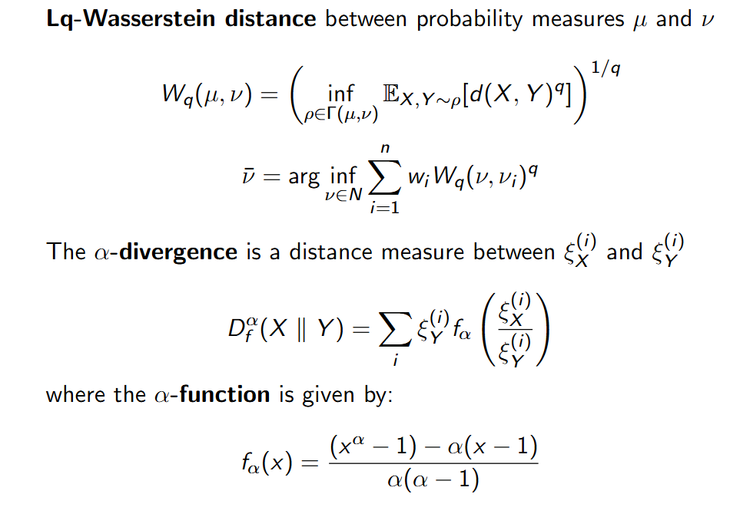

Slide 4
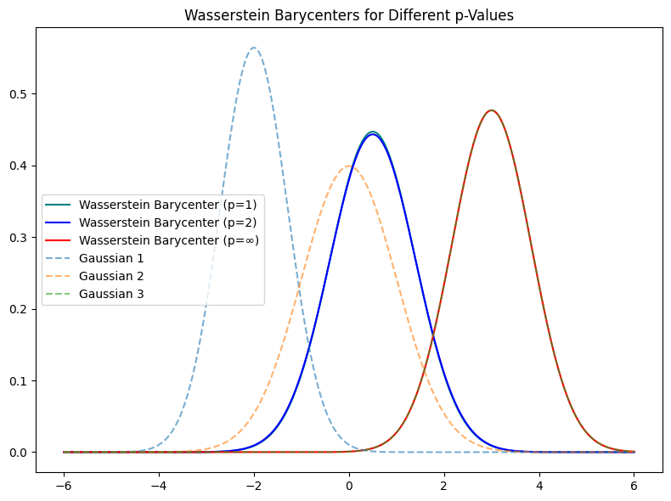

Slide 5
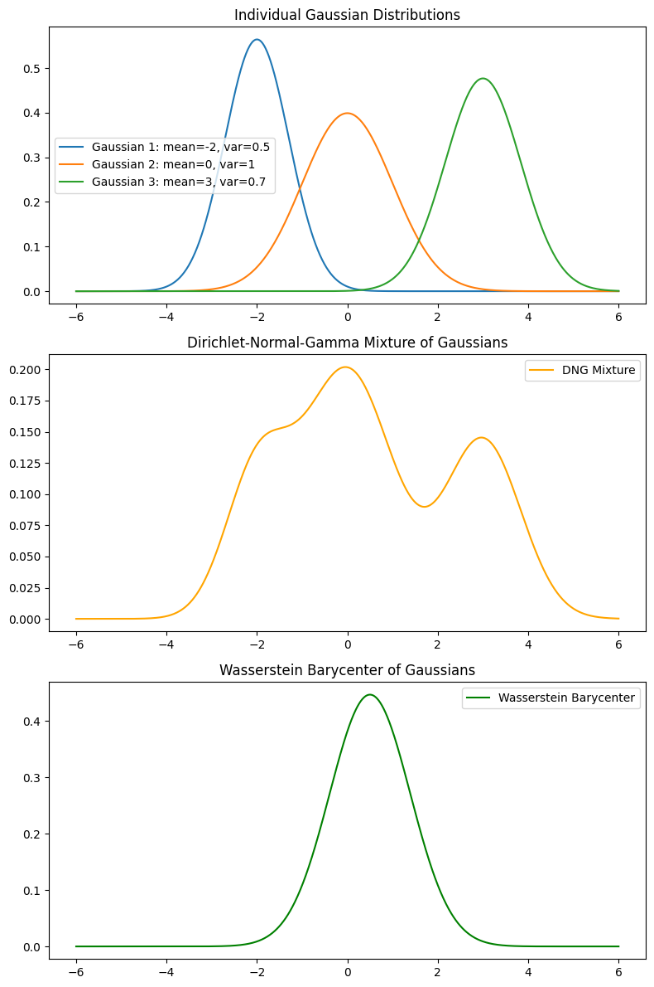
Comparison of DNG and Wasserstein on distributions

Slide 6
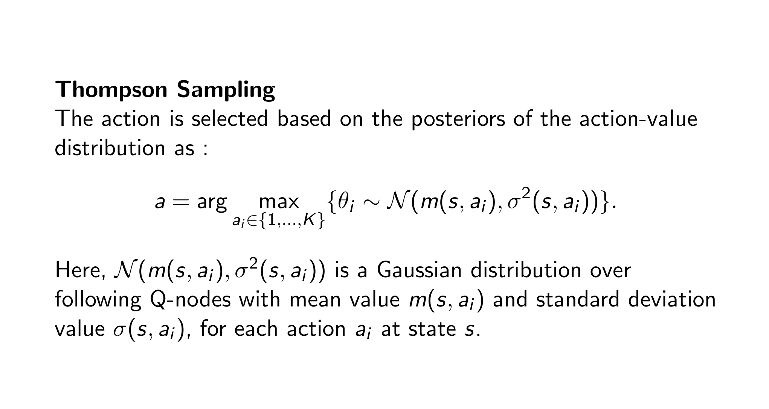
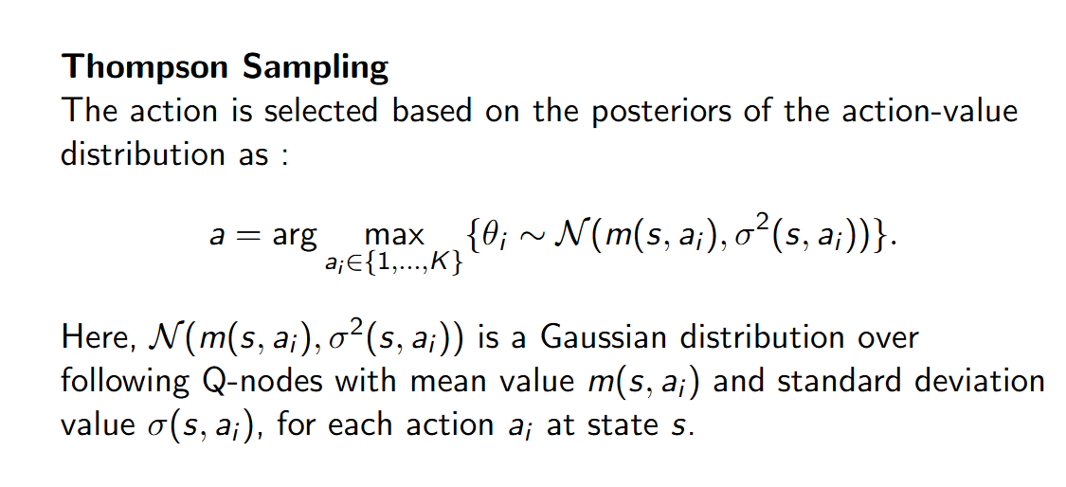

Slide 7
Visualisation of Thompson Sampling

Slide 8
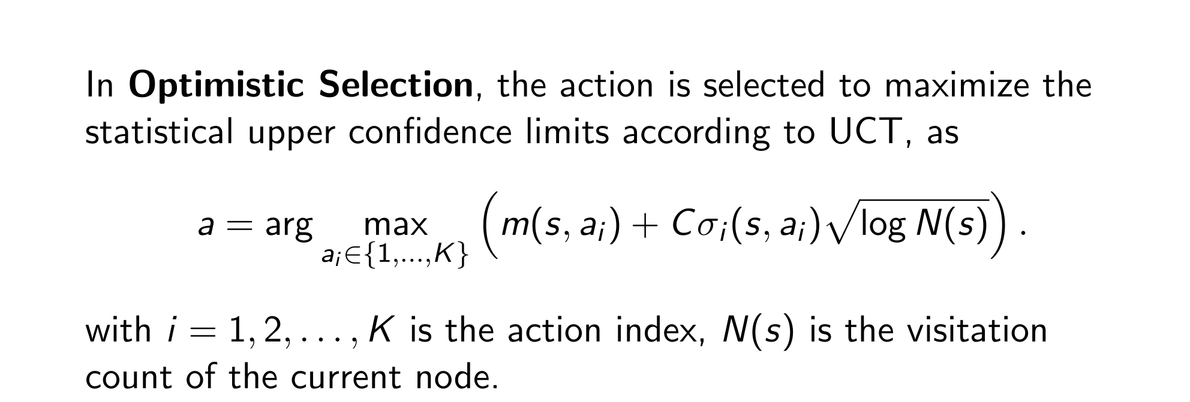
Optimistic selection

Slide 9
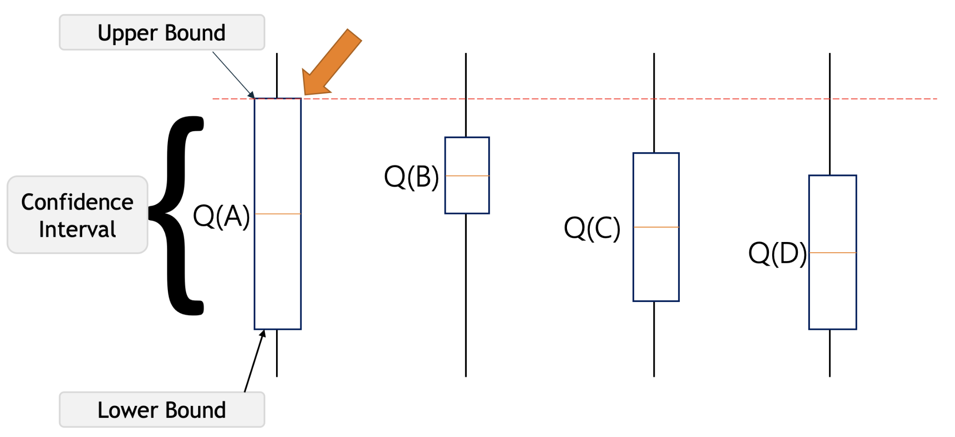

Slide 10
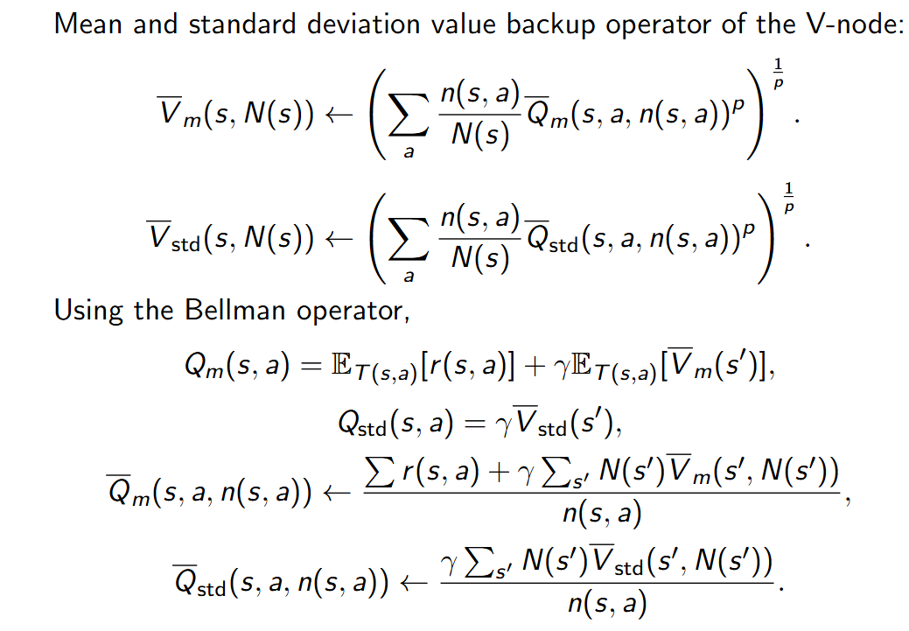
Backup Operator

Slide 11
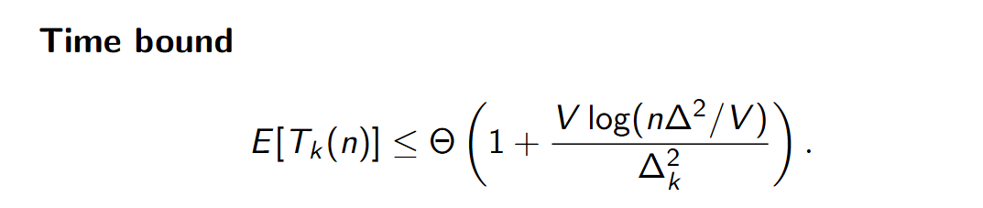
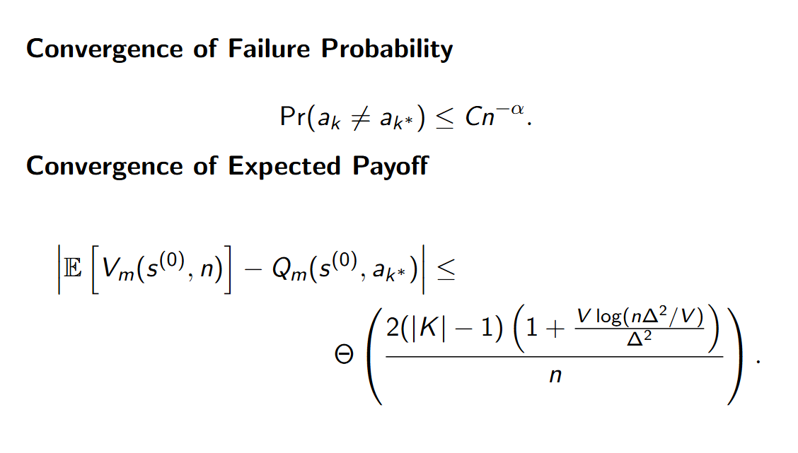
Theoretical Analysis

Slide 12
Games on OpenAI gym
Frozen Lake Taxi

Slide 13
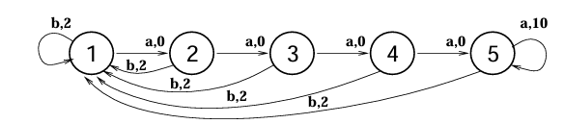
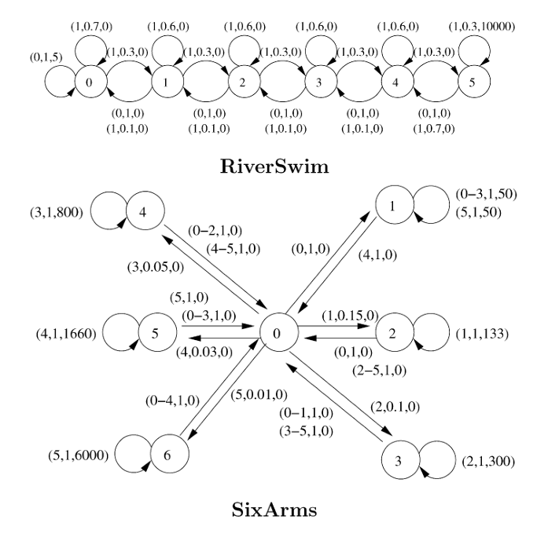
Visualisation of NChain and RiverSwim

Slide 14
Visualisation of SixArms

Slide 15
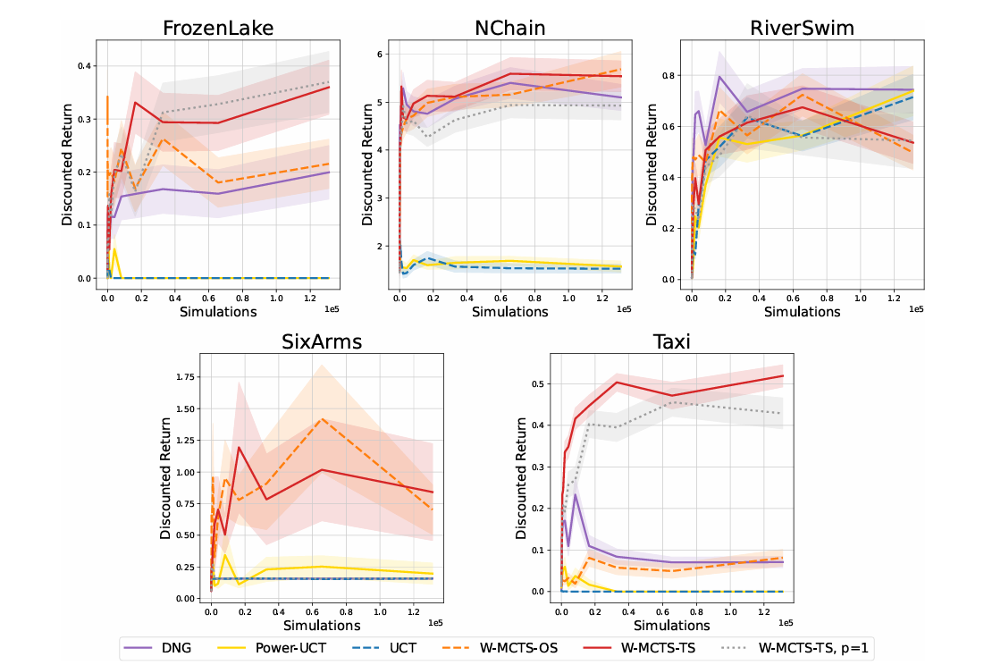

Slide 16
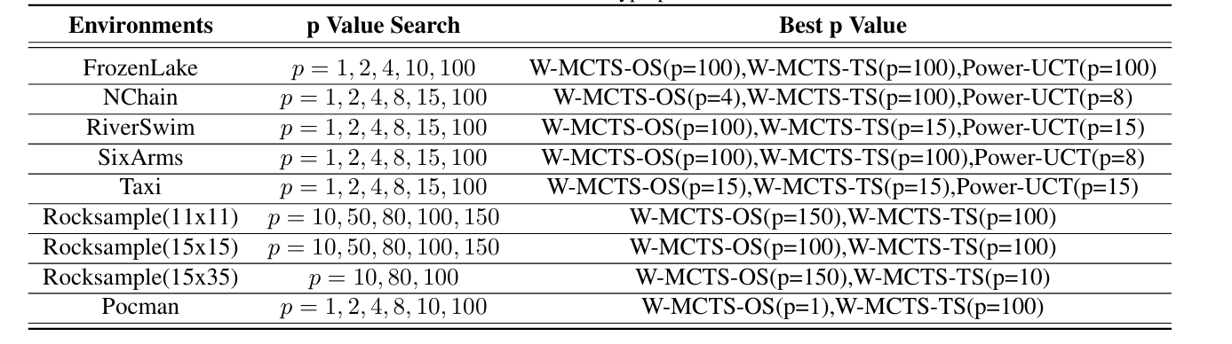
Tunable Hyperparameters for Power-UCT

Slide 17
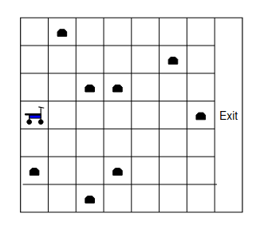
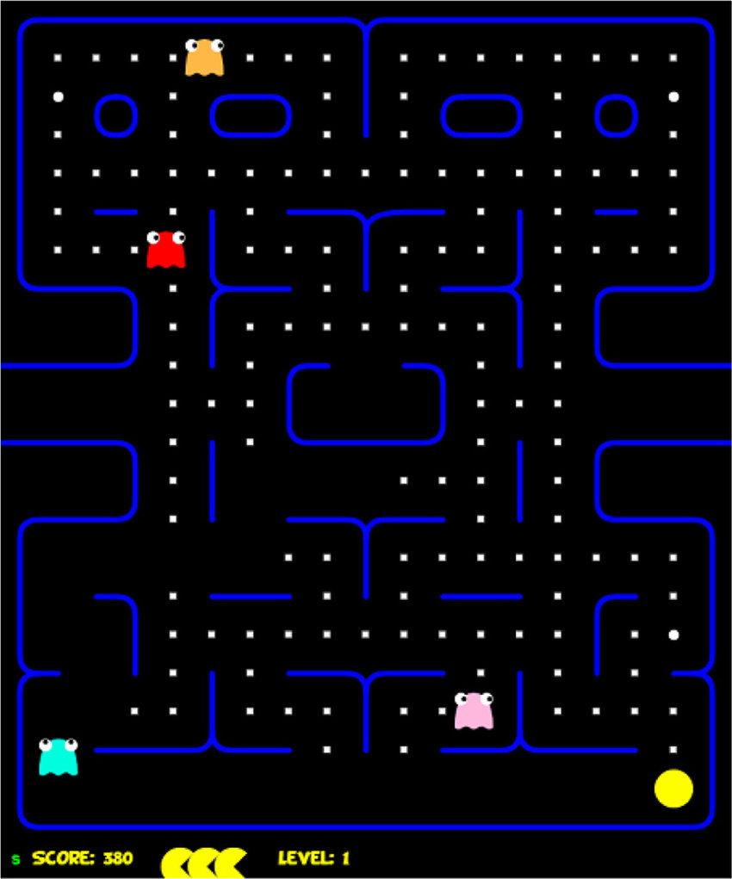
Visualisations of Rocksample and Pocman

Slide 18
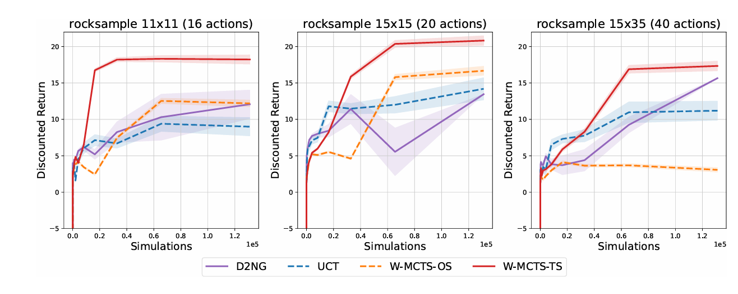
Results on Partially Observable MDPs

Slide 19
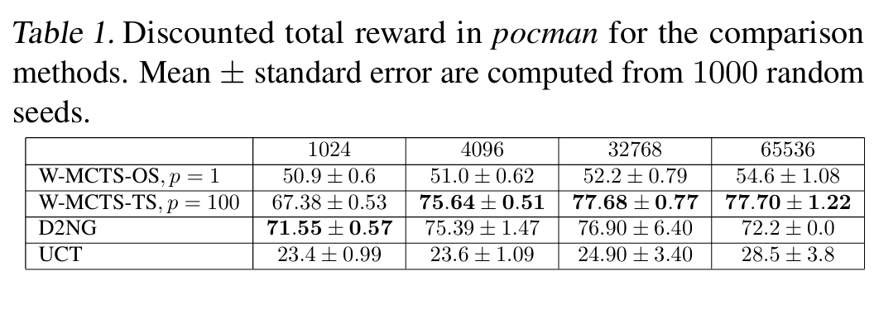
Results of Pocman game

